Slide 1
Science with Dr. Christina Rahm We will get started shortly.

Slide 2
Medical Disclaimer:
The information provided is for educational purposes and is not intended as medical advice, or a substitute for the medical advice of a physician or other qualified health care professional. You should not use this information for diagnosing a health or fitness problem or disease. You should always consult with a doctor or other health care professional for medical advice or information about diagnosis and treatment.
Notes:
The information provided is for educational purposes and is not intended as medical advice, or a substitute for the medical advice of a physician or other qualified health care professional. We do not aim to diagnose, treat, cure or prevent any illness or disease. You should always consult with a doctor or other health care professional for medical advice or information about diagnosis and treatment. The information in this presentation has not been evaluated by the Food & Drug Administration or any other medical body.

Slide 3
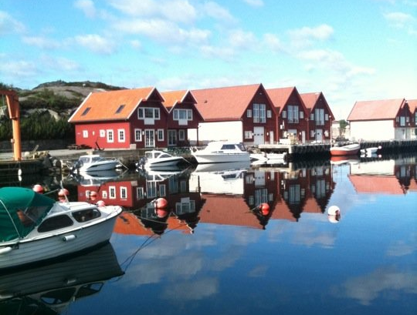
Dr. Dori Naerbo, Ph.D.
Notes:
Good morning, good afternoon, good evening…wherever you are in the world this is Dr. Dori Naerbo and I am your host on today’s call. For those of you who do not know me…I am a clinical researcher and author of several books.

Slide 4
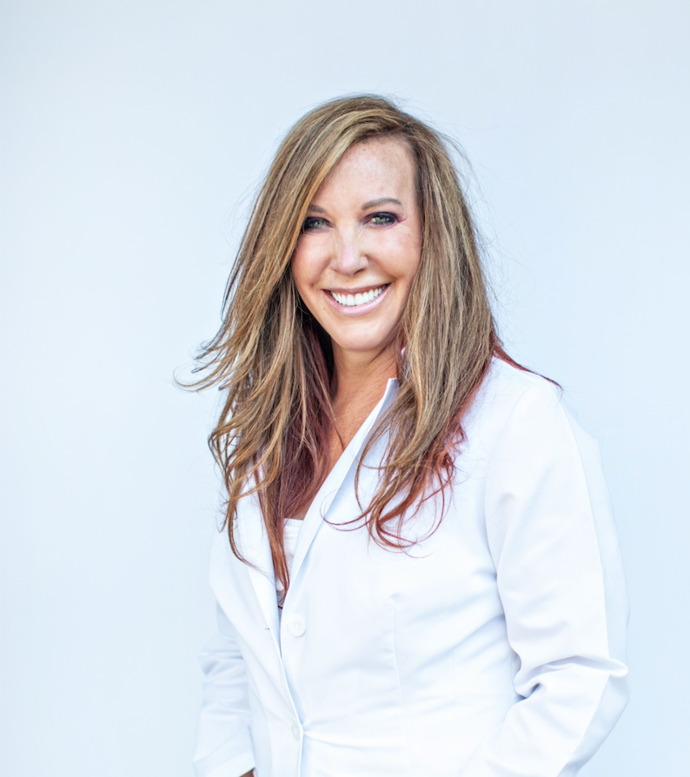
Dr. Christina Rahm CEO & Chief Science Officer

Slide 5
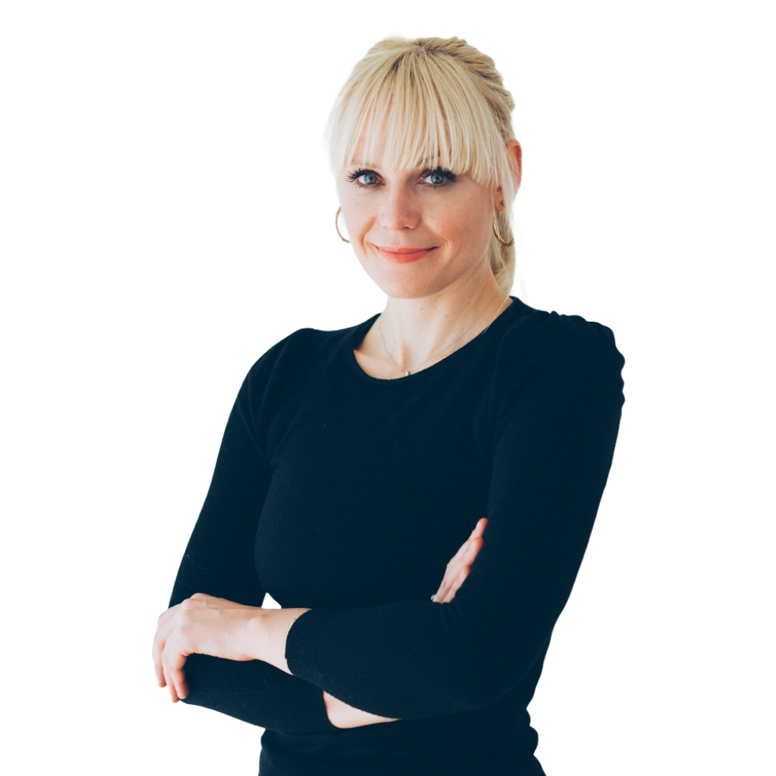
Dr. Tina Božičnik

Slide 6
ISNS Case Study Presented by: Dr. Tina Božičnik

Slide 7
DEPRESSION
Depression is a recurrent disorder and more prevalent in females than males. Depression affects at least 322 million people globally, or approximately 4.4% of the world’s population.
Treatment often consists of antidepressants, most popular being Prozac, Lexapro, Zoloft, Viibryd, etc., or other alternative treatments such as psychotherapy are also available. However, there are are concerns about the possible negative effects associated with taking antidepressants. Due to this, some researchers have been looking for natural therapeutic options to help with depression.

Slide 8
International Science and Nutrition Society – CURARE CAUSAM – ISNS 2021

Slide 9
PROPRIETARY BLENDS LEGEND
Proprietary blend I: Silica, Vitamin C, and Trace Minerals
Proprietary blend II: N-acetyl L-tyrosine, Anhydrous Caffeine, L-theanine, Velvet Bean Seed, Pine Bark, Curcumin, and Vitamin D
Proprietary blend III: Black seed oil, Resveratrol, turmeric, Raspberry Ketones, Apple Cider Vinegar, Aloe Vera, and D-Ribose
International Science and Nutrition Society – CURARE CAUSAM – ISNS 2021

Slide 10
ISNS CASE STUDY I: Depression with Schizoaffective disorder
Patient: Female
Age: 68-year-old
History: A 68-year-old female with a history of severe Schizoaffective disorder with severe depression since 1996. Her symptoms included lack of motivation, almost non active during the day, immersed into her own thoughts, and experienced fears. She was on antidepressants and experienced severe extrapyramidal side effects; therefore, she was on Biperiden (Akinetone), Rsperidone (Risset) and Paroxetine tablets. She had marked signs of insulin resistance. Her family reported severe problems with the ability to focus, deepening depression up to the point where she stopped eating and needed to be hospitalized for I.V. fluids several times in 2 consecutive years. Her past medical history showed no significant reports.
Treatment/ Method: She began on 10 drops of Proprietary blend 1 and 1 capsule Proprietary blend 2 B.I.D. After seeing some improvements in her symptoms, she then increased to Proprietary blend 2, 2-3 times a day.
(Results on next slide)
International Science and Nutrition Society – CURARE CAUSAM – ISNS 2021

Slide 11
ISNS CASE STUDY I: Depression with Schizoaffective disorder
Results: 5- months after the beginning of treatment the family and herself started noticing dramatic changes. She started experiencing more clarity of thought, she was more focused, she could remember more detailed things that have happened in her past, her mood was better and more stabile, for the first time after years she was motivated, happier, her headaches were gone. Her energy levels increased and sleep improved.
7-months after the beginning of treatment her psychiatrist saw such an improvement that they tried reducing her medication and 9-months after the start she managed to came off all her medication. Once her dose was tampered, she started using 1 Proprietary blend 2 capsule in the morning, one in the afternoon and one at night before bedtime. She didn’t experience any antidepressant withdrawal side effects.
She also dropped 12 kg of her body weight and reports that she continues to notice improvements in her quality of life in addition to all the positive changes that already happened and feel like the impossible became possible.
International Science and Nutrition Society – CURARE CAUSAM – ISNS 2021

Slide 12
DISCUSSED: POSSIBLE CAUSES OF DEPRESSION
Micronutrient Deficiency
Heavy Metal Toxicity
Diminished Dopaminergic Neurotransmission
Unbalanced Microbiome

Slide 13
Micronutrient Deficiency
One possible cause of depression is trace mineral deficiency. There is recent empirical evidence of the association between several micronutrients—zinc, magnesium, selenium—and depression as well as obesity. Potential mechanisms of action involve the HPA axis, glutamate homeostasis and inflammatory pathways.
https://www.ncbi.nlm.nih.gov/labs/pmc/articles/PMC5986464/

Slide 14
Heavy Metal Toxicity
The human brain is susceptible to a variety of toxic chemicals because of natural selection that favors brain structures promoting advanced brain functions such as long-term memory and rapid learning. Heavy metals can damage neurons and trigger depression. Biochemical factors make humans extremely susceptible to neuropsychiatric diseases caused by exposures to a variety of toxic chemicals. Especially cadmium is associated with increased likelihood of depression.
Cite:
https://www.greatplainslaboratory.com/articles-1/2015/11/13/the-unique-vulnerability-of-the-human-brain-to-toxic-chemical-exposure-and-the-importance-of-toxic-chemical-evaluation-and-treatment-in-orthomolecular-psychiatry
https://www.ncbi.nlm.nih.gov/labs/pmc/articles/PMC4158644/
https://minervaaccess.unimelb.edu.au/bitstream/handle/11343/263200/PMC4120423.pdf
International Science and Nutrition Society – CURARE CAUSAM – ISNS 2021

Slide 15
Diminished Dopaminergic Neurotransmission
Multiple sources of evidence support a role for diminished dopaminergic neurotransmission in in depression. Moreover, negative symptoms, as well as extrapyramidal symptoms and certain depressive symptoms, may be manifestations of regionally deficient dopaminergic activity.
https://jamanetwork.com/journals/jamapsychiatry/article-abstract/482227

Slide 16
Unbalanced Microbiome
There has been a link between an unbalanced microbiome and mental health. In one direction, the central nervous system sends signals to the gut environment, which modulate microbiota composition and function. In the other direction, microbiota either interface with components of the peripheral nervous system that directly relay signals to the central nervous system, such as the vagus nerve innervating the brainstem or afferent fibers traveling in sympathetic nerve bundles and innervating the spinal cord, or do so indirectly, such as via moderation by the enteric nervous system. Evidence suggests that the microbiome can also signal to the central nervous system by way of neuroactive metabolites in the blood stream (11). Therefore, gut health plays a major role.
Cite: https://www.ncbi.nlm.nih.gov/labs/pmc/articles/PMC6995775/
International Science and Nutrition Society – CURARE CAUSAM – ISNS 2021

Slide 17
RESEARCH STUDIES: PROPRIETARY BLEND I SILICA/ZEOLITES TRACE MINERALS VITAMIN C
Silica/ Zeolites
In lead-intoxicated mice, a study showed that a clinoptilolite sorbent KLS-10-MA decreased the lead accumulation in the intestine by more than 70%.
https://www.ncbi.nlm.nih.gov/labs/pmc/articles/PMC6277462/
Vitamin C
A 2018 study consisting of two groups of males supplemented vitamin C (adequate vitamin C (≥ 50 μmol/L, n = 99) and inadequate vitamin C (< 50 μmol/L, n = 40)); the data showed that the inadequate vitamin C group had significantly higher greater disturbance, mood disturbance (p = 0.024), depression (p = 0.012), and confusion (p = 0.022).
https://bmcpsychiatry.biomedcentral.com/articles/10.1186/s12888-020-02730-w
Trace Minerals
For example, in one study, 2-month-old male rats were fed zinc adequate, zinc deficient, and supplemented zinc for 3 weeks; the results showed that zinc deficient mice displayed anorexia, reduced water intake, and increased anxiety-like behaviors.
https://www.sciencedirect.com/science/article/abs/pii/S0031938408002096

Slide 18
RESEARCH STUDIES: PROPRIETARY BLEND II N-acetyl L-tyrosine Anhydrous Caffeine L-theanine Velvet Bean Seed Pine Bark Curcumin Vitamin D
N-Acetyl L-Tyrosine
Subjects were given a 100 mg/kg dose of tyrosine and then exposed for 4.5 hours to cold and hypoxia in this double-blind, placebo-controlled crossover study. Tyrosine was reported to significantly decrease adverse symptoms, including mood and performance impairment.
https://www.researchgate.net/publication/232052024_Tyrosine_Food_Supplement_or_Therapeutic_Agent
Anhydrous Caffeine
To assess the link between caffeine and depression, a meta-analysis demonstrated that caffeine consumption decreased the risk of depression bh 8%; the association became significant when the caffeine consumption was about 68/mg/day and below 509 mg/day.
https://pubmed.ncbi.nlm.nih.gov/26339067/
L-Theanine
In a study, 20 subjects with major depressive disorder had L-theanine added to the current medication of each participant for 8 weeks; results showed anxiety-trait scores decreased, as well as sleep quality increased after administration of L-theanine.
https://pubmed.ncbi.nlm.nih.gov/27396868/

Slide 19
RESEARCH STUDIES: PROPRIETARY BLEND II (Continued) N-acetyl L-tyrosine Anhydrous Caffeine L-theanine Velvet Bean Seed Pine Bark Curcumin Vitamin D
Vitamin D
In a large analysis, out of the participants aged 18-65 years-old with major depressive disorder or normal, it was found that 33.6% had deficient vitamin D levels; as compared with controls, lower vitamin D levels were found in participants with current particularly in those with the most severe symptoms
https://www.nature.com/articles/mp201336
Curcumin
In an adult male Wistar–Kyoto rat model of depression, it showed that curcumin had an antidepressant activity and found an increase in hippocampal BDNF. In stressed mice, curcumin also had positive effects on stress-induced learning and memory deficits and an upregulation of BDNF and ERK in the hippocampus.
https://www.frontiersin.org/articles/10.3389/fpsyt.2020.572533/full
Velvet Bean Seed
The anti-depressant effect of M. pruriens extract (100 and 200 mg/kg) was investigated for 21 days. The results showed there was significant reduction of the immobility time.
https://www.ncbi.nlm.nih.gov/labs/pmc/articles/PMC4213977/
Pine Bark
Researchers studied the ameliorative effect of Pycnogenol (extract of pine bark) on depression-like behavior in chronic corticosterone- (CORT-) treated mice for 20 days. The results indicate that mice orally administered PYC had significantly shortened immobility time, and therefore may serve to reduce CORT-induced stress by radical scavenging activity.
https://www.ncbi.nlm.nih.gov/labs/pmc/articles/PMC4036684/

Slide 20
References
References
https://www.ncbi.nlm.nih.gov/labs/pmc/articles/PMC5986464/
https://www.greatplainslaboratory.com/articles-1/2015/11/13/the-unique-vulnerability-of-the-human-brain-to-toxic-chemical-exposure-and-the-importance-of-toxic-chemical-evaluation-and-treatment-in-orthomolecular-psychiatry
https://minervaaccess.unimelb.edu.au/bitstream/handle/11343/263200/PMC4120423.pdf
https://jamanetwork.com/journals/jamapsychiatry/article-abstract/482227
https://www.ncbi.nlm.nih.gov/labs/pmc/articles/PMC6995775/
https://www.ncbi.nlm.nih.gov/labs/pmc/articles/PMC6277462/
https://www.mayoclinic.org/diseases-conditions/depression/diagnosis-treatment/drc-20356013
https://bmcpsychiatry.biomedcentral.com/articles/10.1186/s12888-020-02730-w
https://www.sciencedirect.com/science/article/abs/pii/S0031938408002096
https://www.researchgate.net/publication/232052024_Tyrosine_Food_Supplement_or_Therapeutic_Agent
https://pubmed.ncbi.nlm.nih.gov/26339067/
https://pubmed.ncbi.nlm.nih.gov/27396868/
https://www.nature.com/articles/mp201336
https://www.frontiersin.org/articles/10.3389/fpsyt.2020.572533/full
https://www.ncbi.nlm.nih.gov/labs/pmc/articles/PMC4213977/
https://www.ncbi.nlm.nih.gov/labs/pmc/articles/PMC4036684/
International Science and Nutrition Society – CURARE CAUSAM – ISNS 2021

